Slide 1
Cloud computing capstone
Task 2

Slide 2
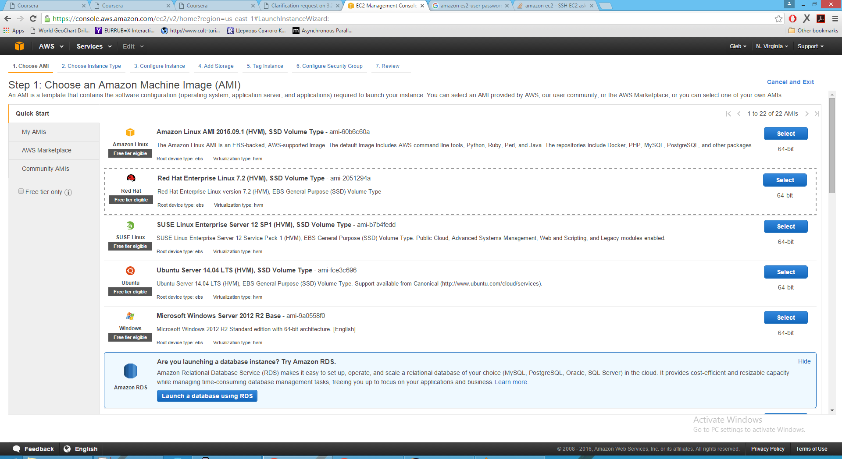
Environment setup - Amazon EC

Slide 3
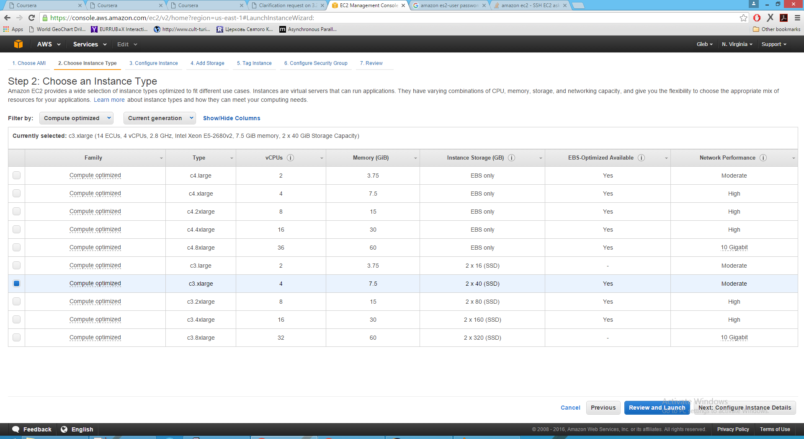
Environment setup - Amazon EC

Slide 4
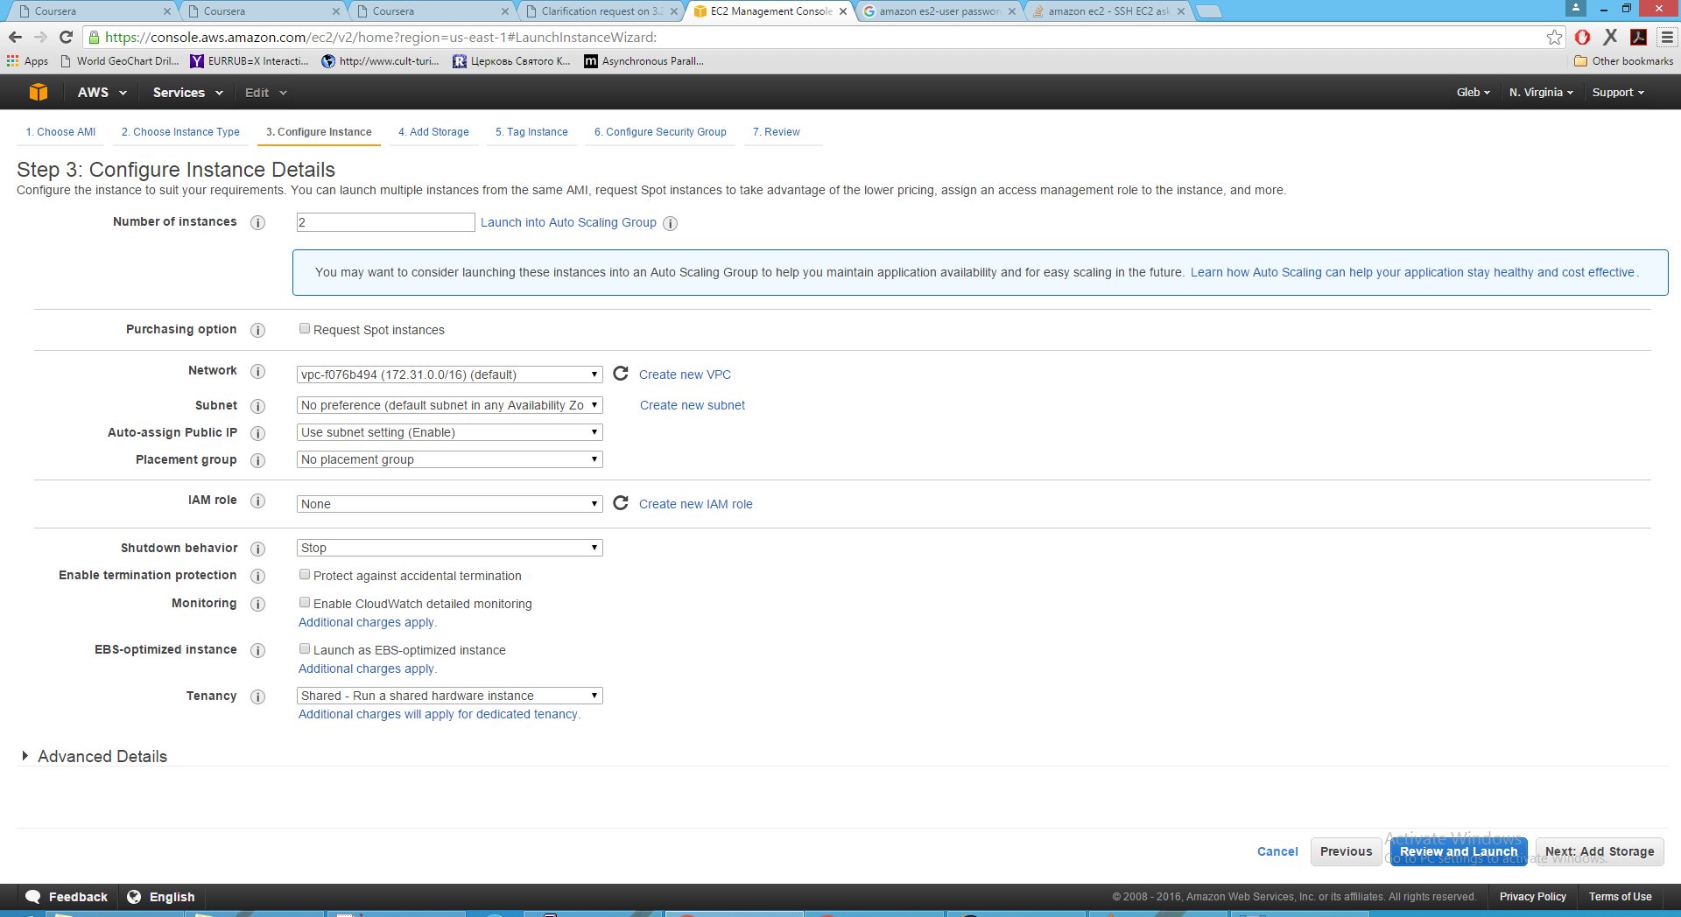
Environment setup - Amazon EC

Slide 5
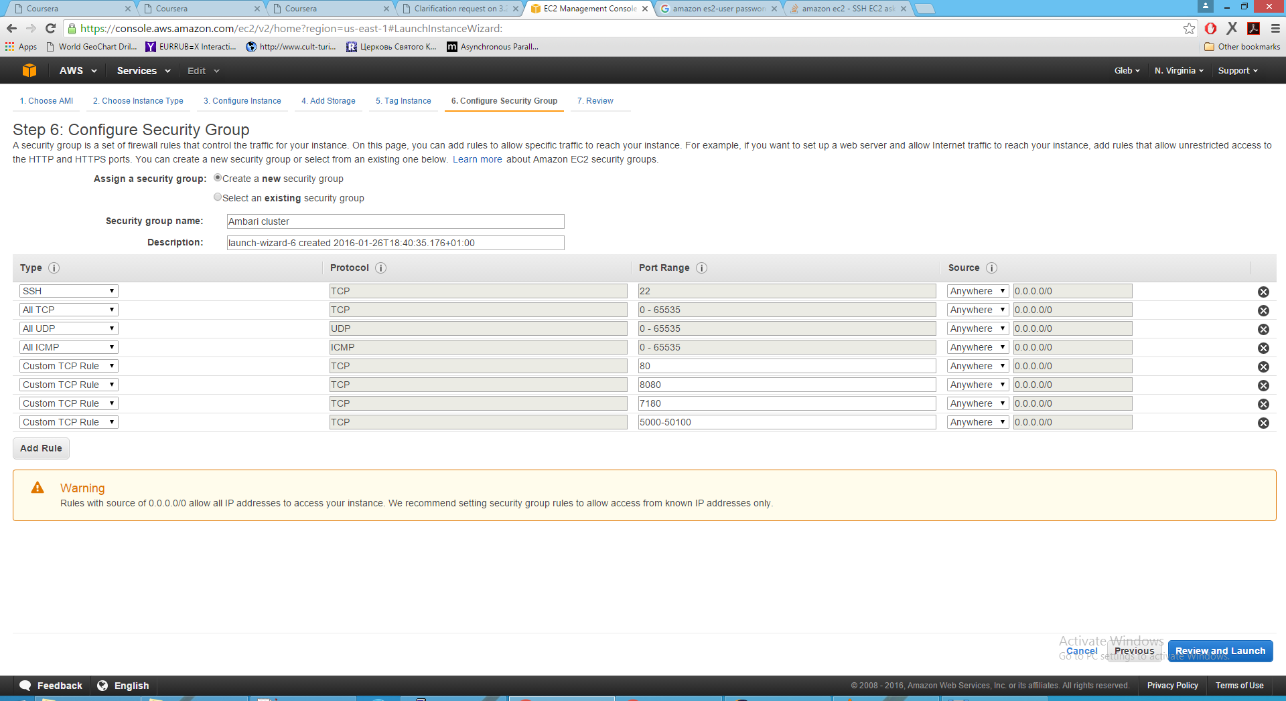
Environment setup - Amazon EC

Slide 6
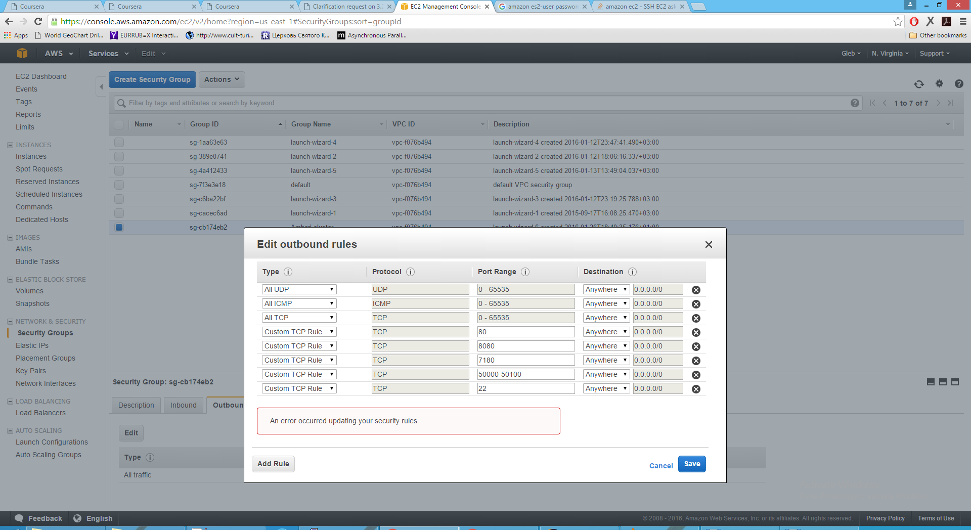
Environment setup - Amazon EC

Slide 7
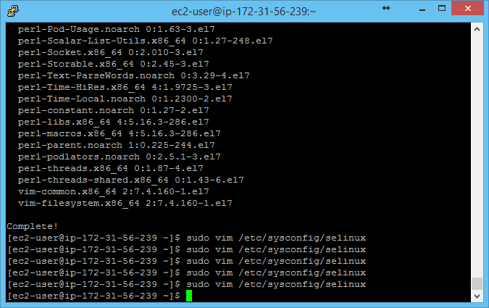
Environment setup - Cluster

Slide 8
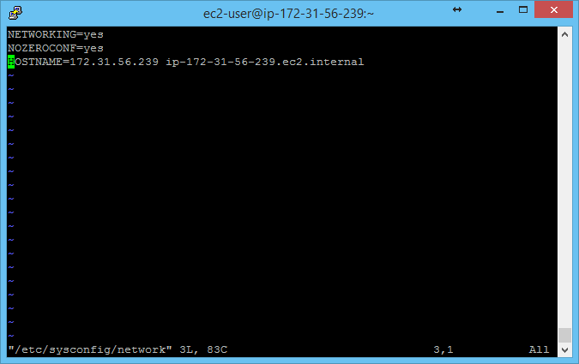
Environment setup - Cluster

Slide 9
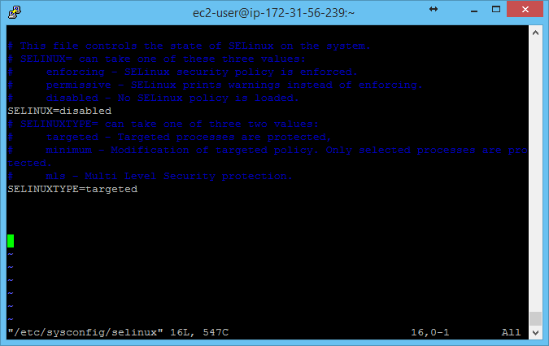
Environment setup - Cluster

Slide 10
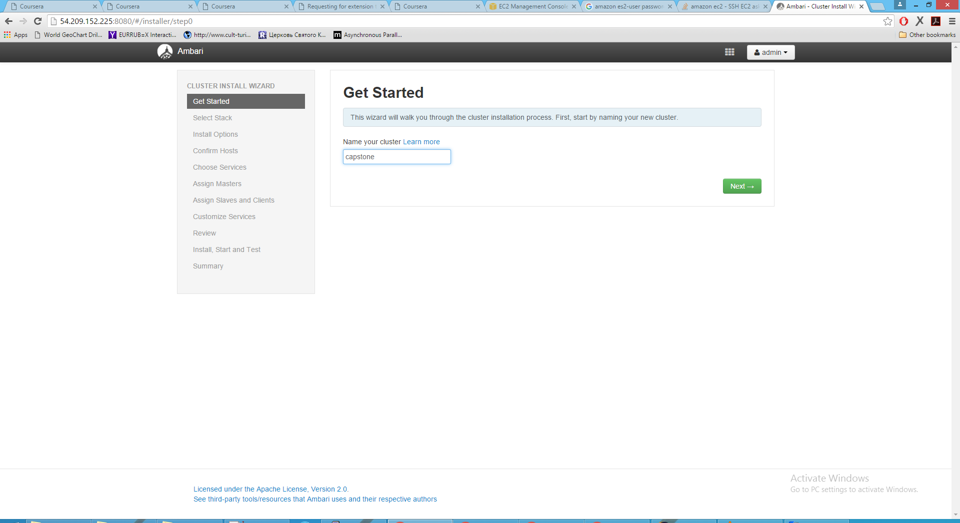
Environment setup – Ambari server

Slide 11
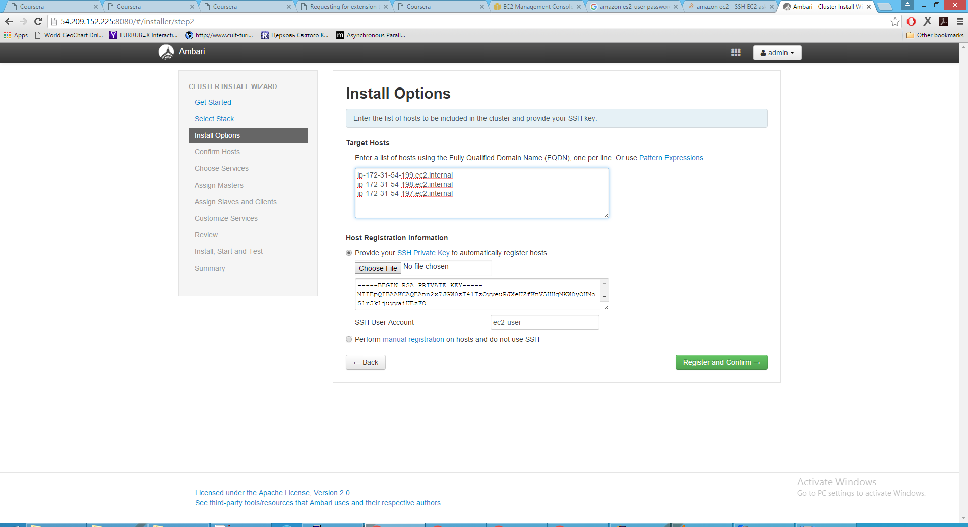
Environment setup – Ambari server

Slide 12
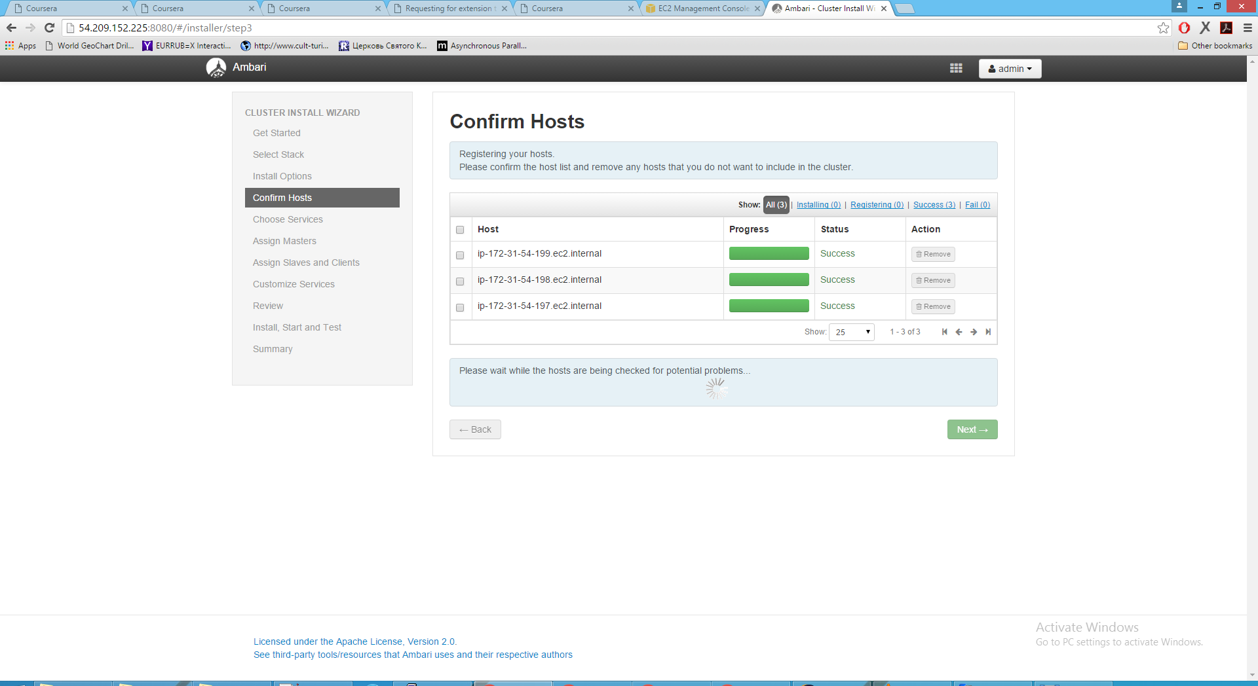
Environment setup – Ambari server

Slide 13
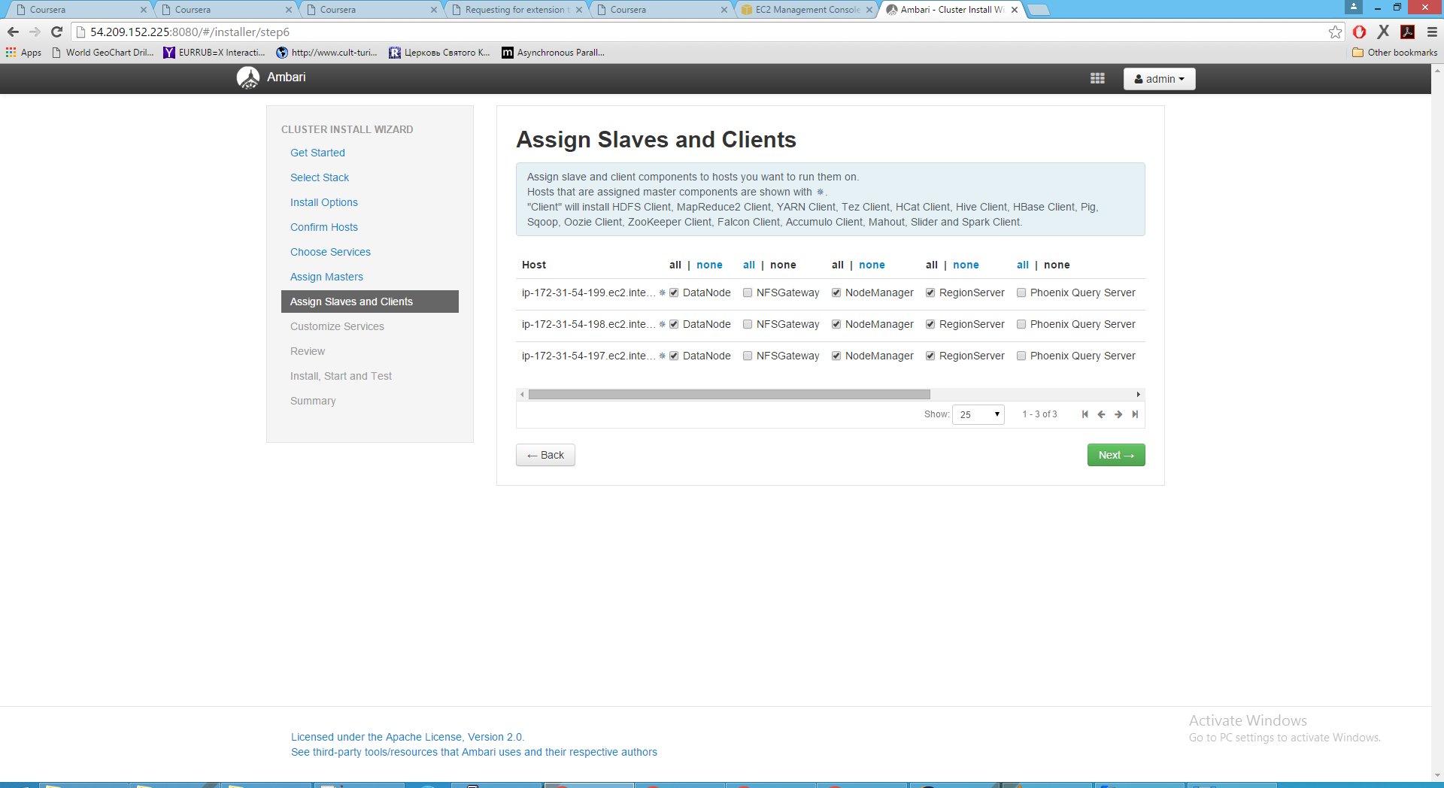
Environment setup – Ambari server

Slide 14
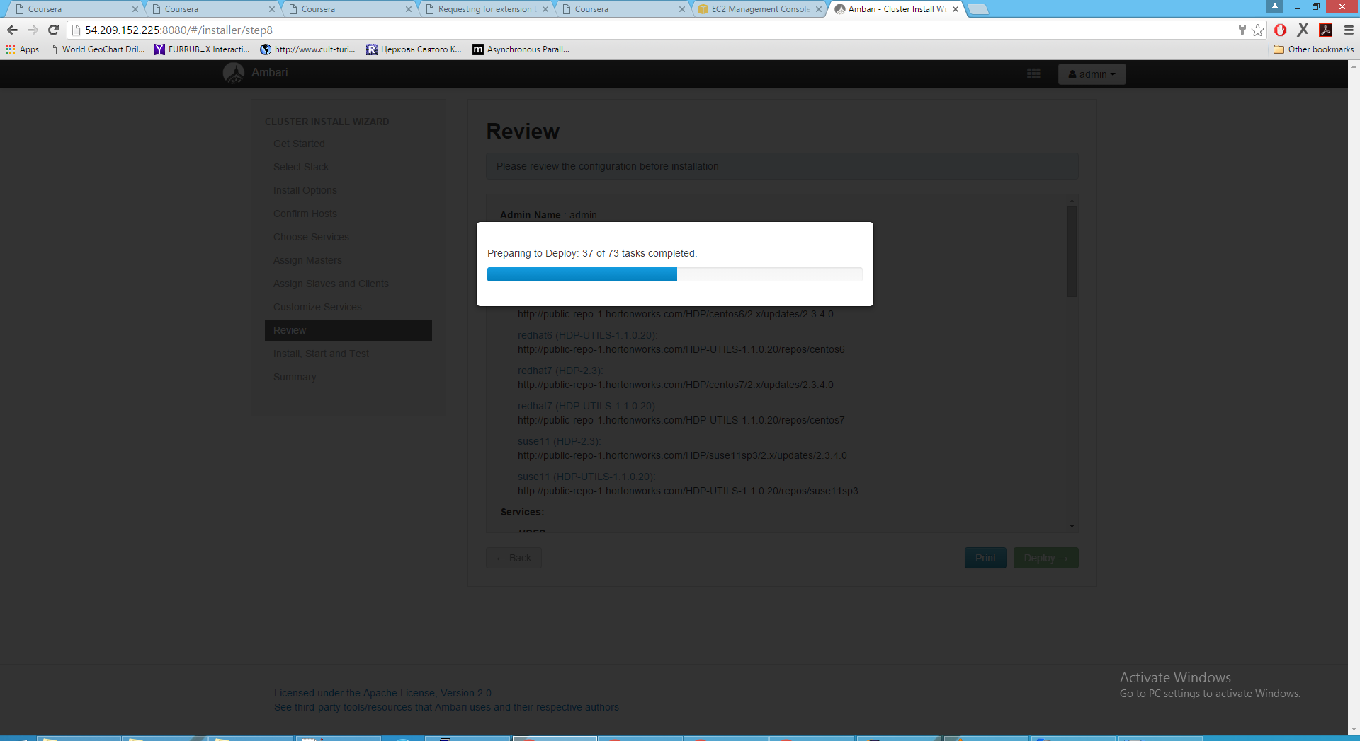
Environment setup – Ambari server

Slide 15
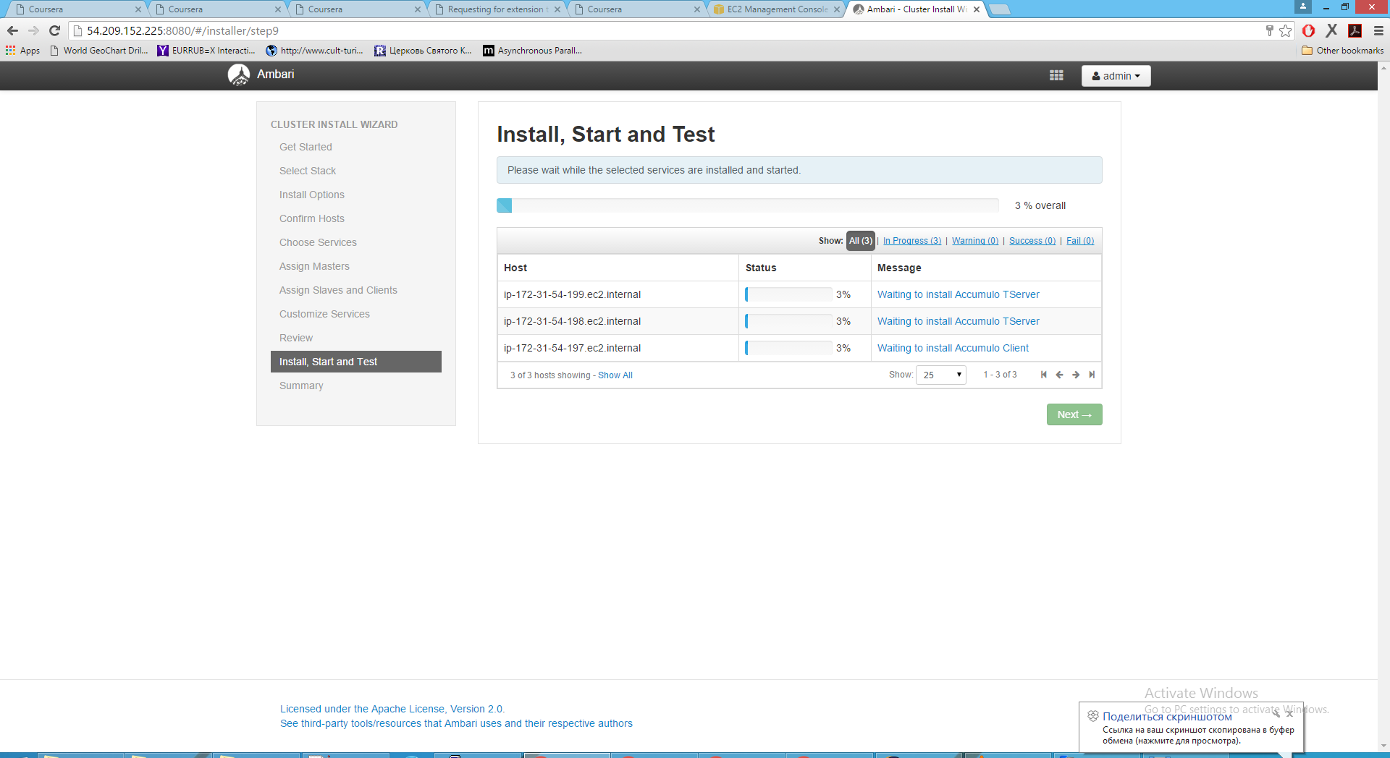
Environment setup – Ambari server

Slide 16
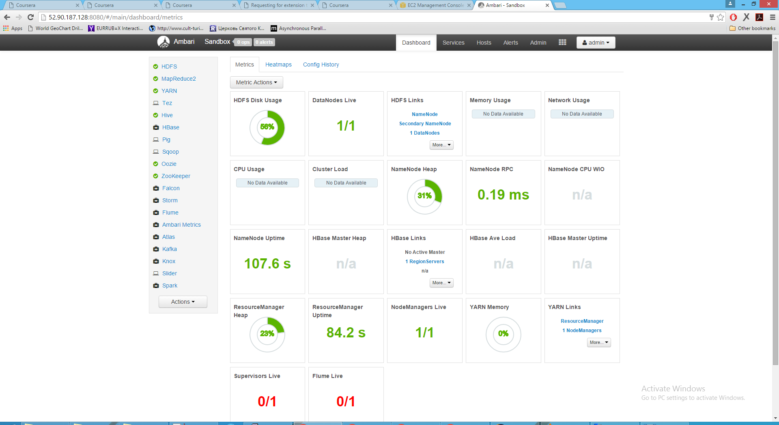
Environment setup – Ambari server

Slide 17
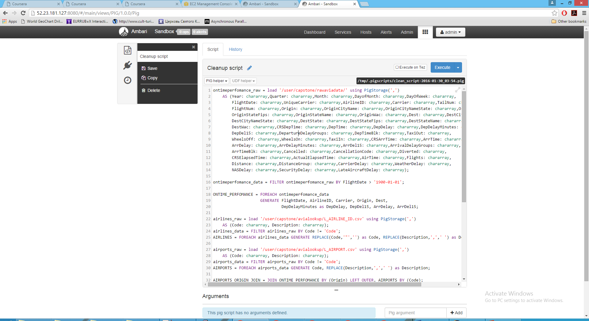
Cleanup data – PIG script

Slide 18
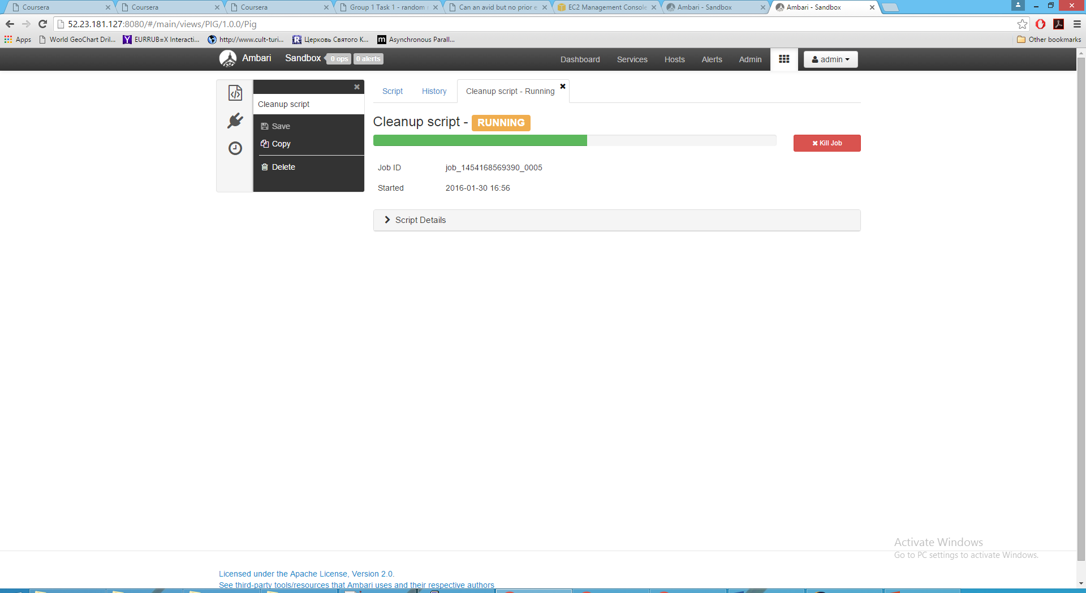
Cleanup data – PIG script

Slide 19
In this task I decided to use Amazon DynamoDB as a storage for processed data.
Unfortunately it is impossible to make queries with OR clause from the Amazon Interface, so I will demonstrate just simple queries.

Slide 20
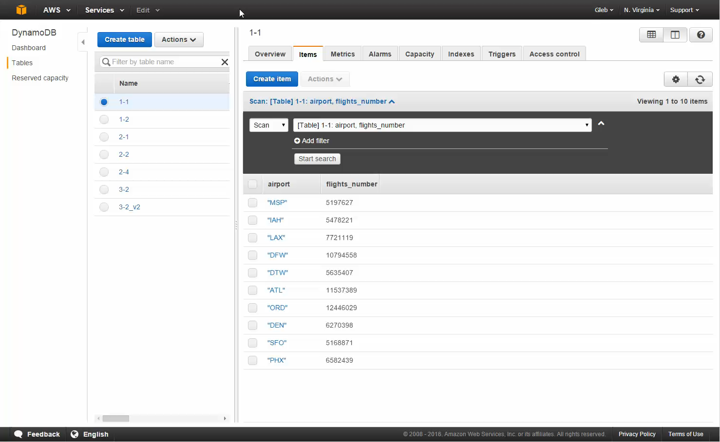
Amazon DynamoDB – Group 1

Slide 21
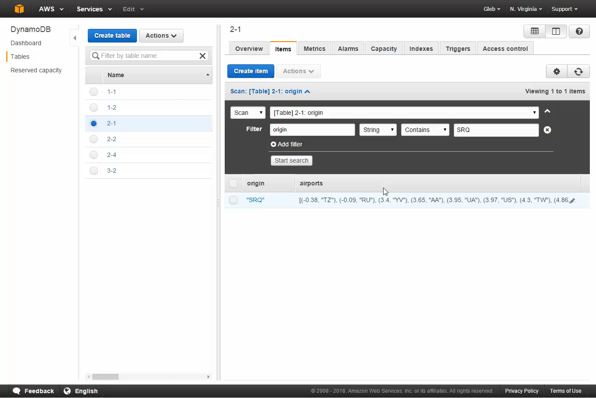
Amazon DynamoDB – Group 2

Slide 22
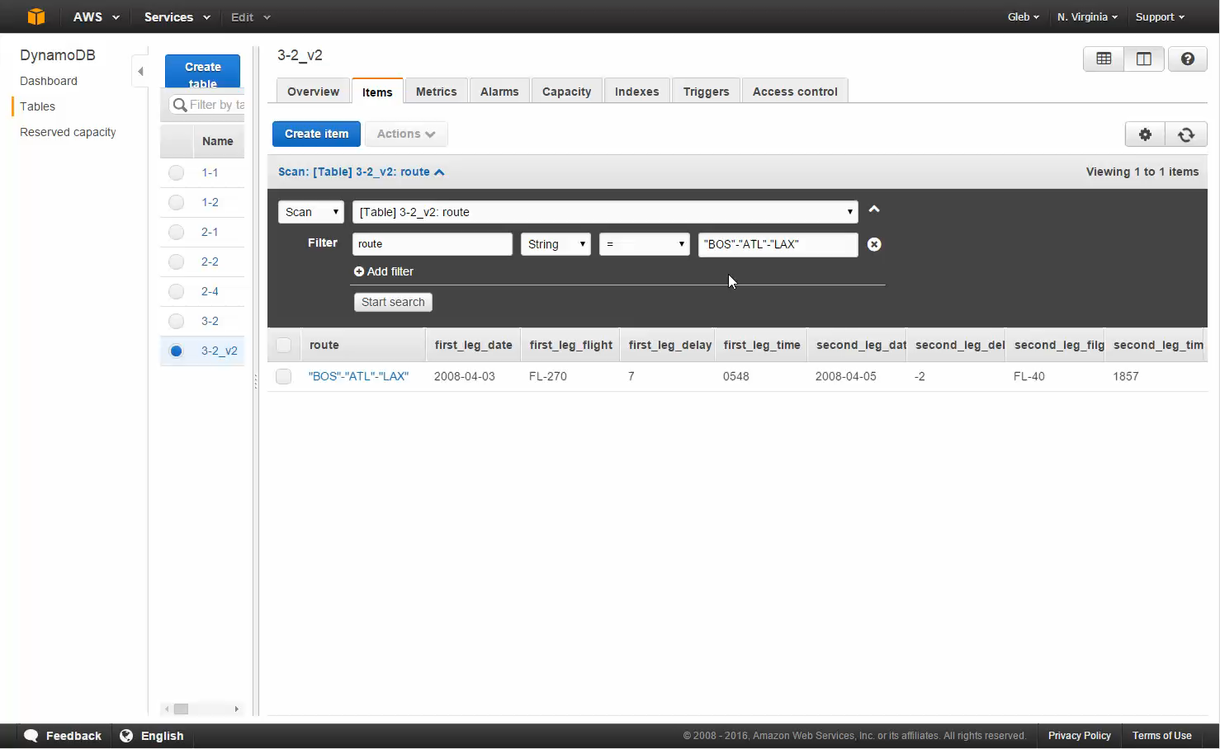
Amazon DynamoDB – Group 3

Slide 23
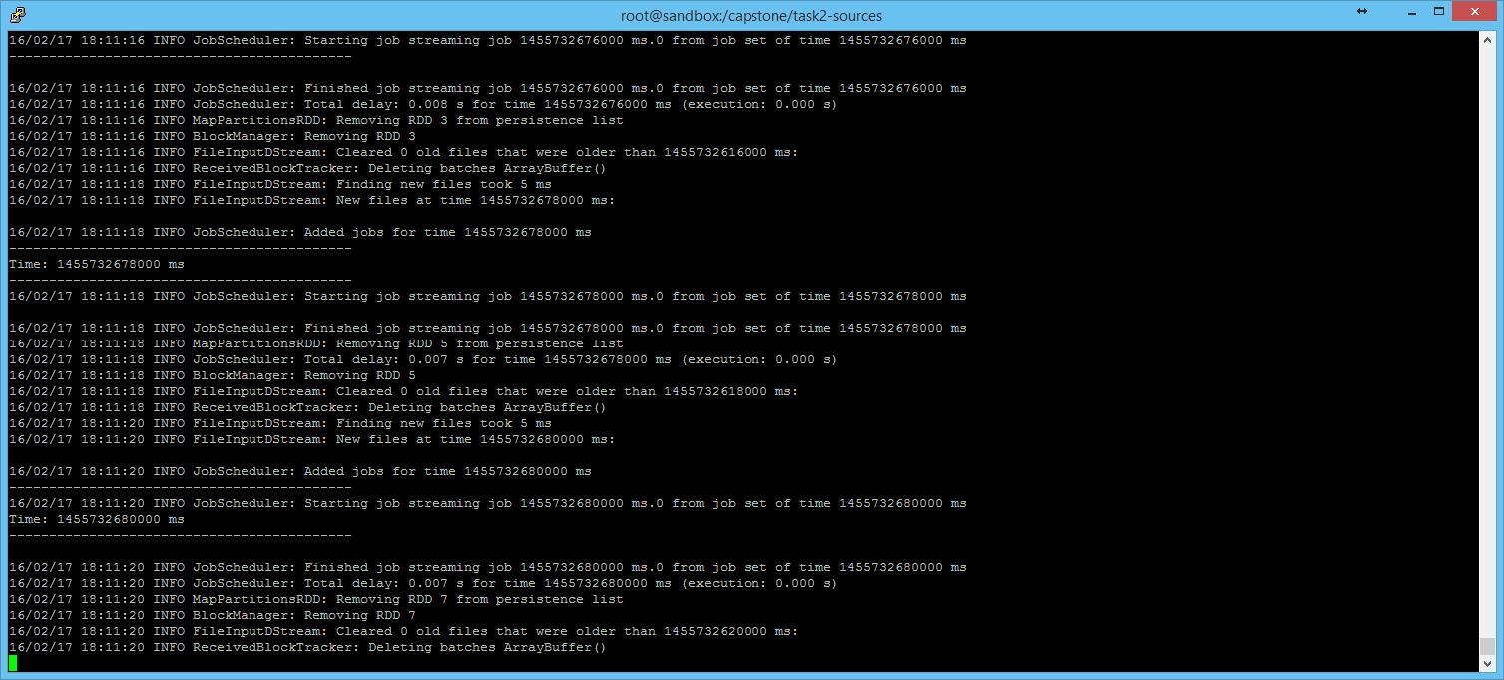
Spark Streaming – Listening state

Slide 24
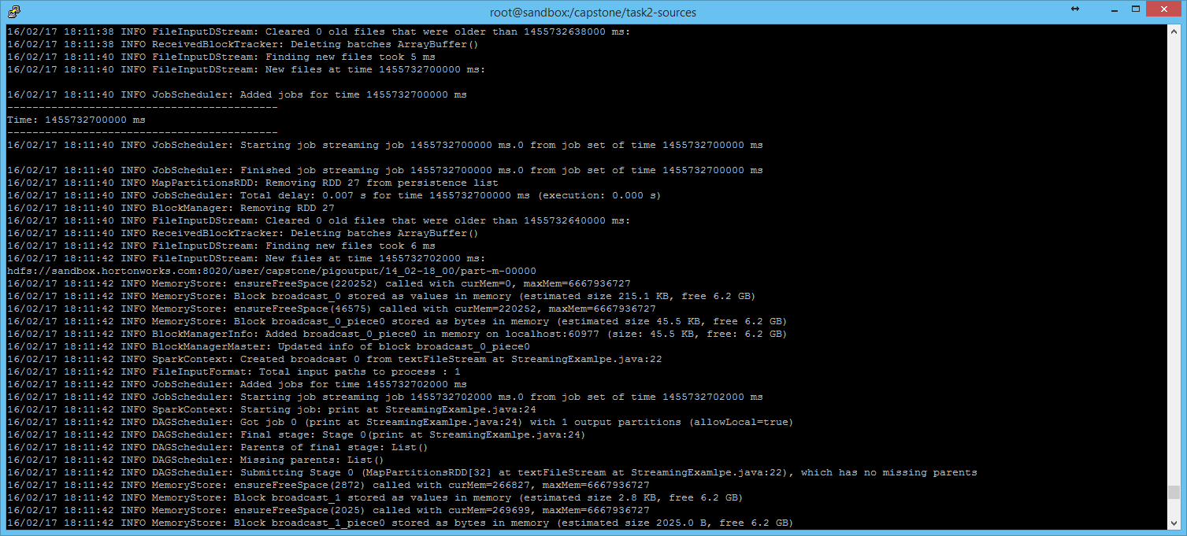
Spark Streaming – Job starting after moving a file to particular directory

Slide 25
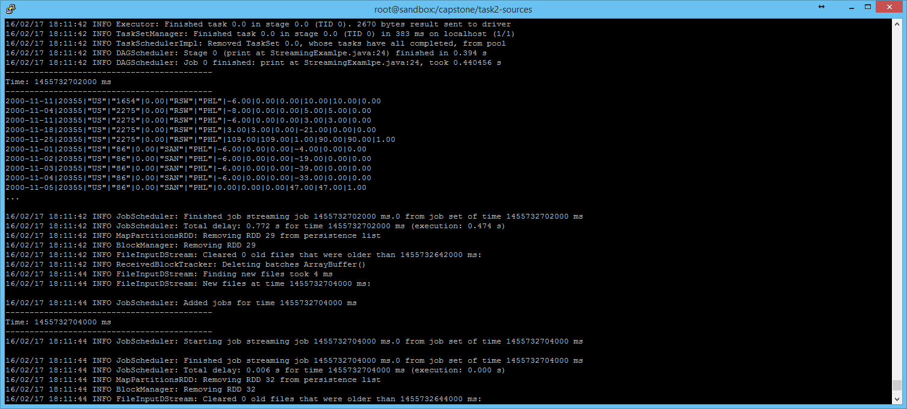
Spark Streaming – End of the job and switching to listening state

Slide 26
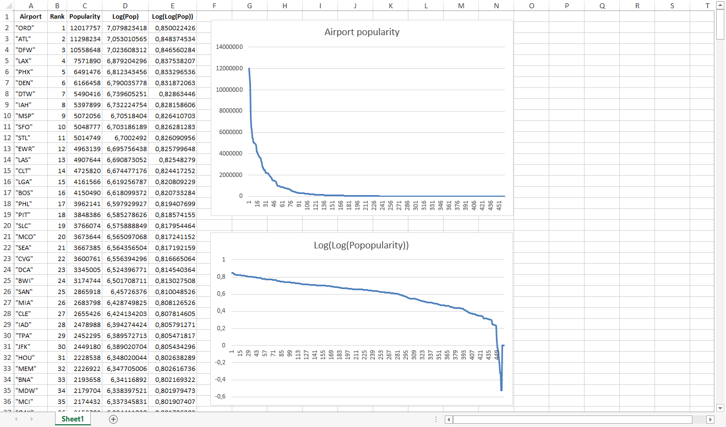
Popular airports – Linear and Log-log graph, Lognormal distribution

Slide 27
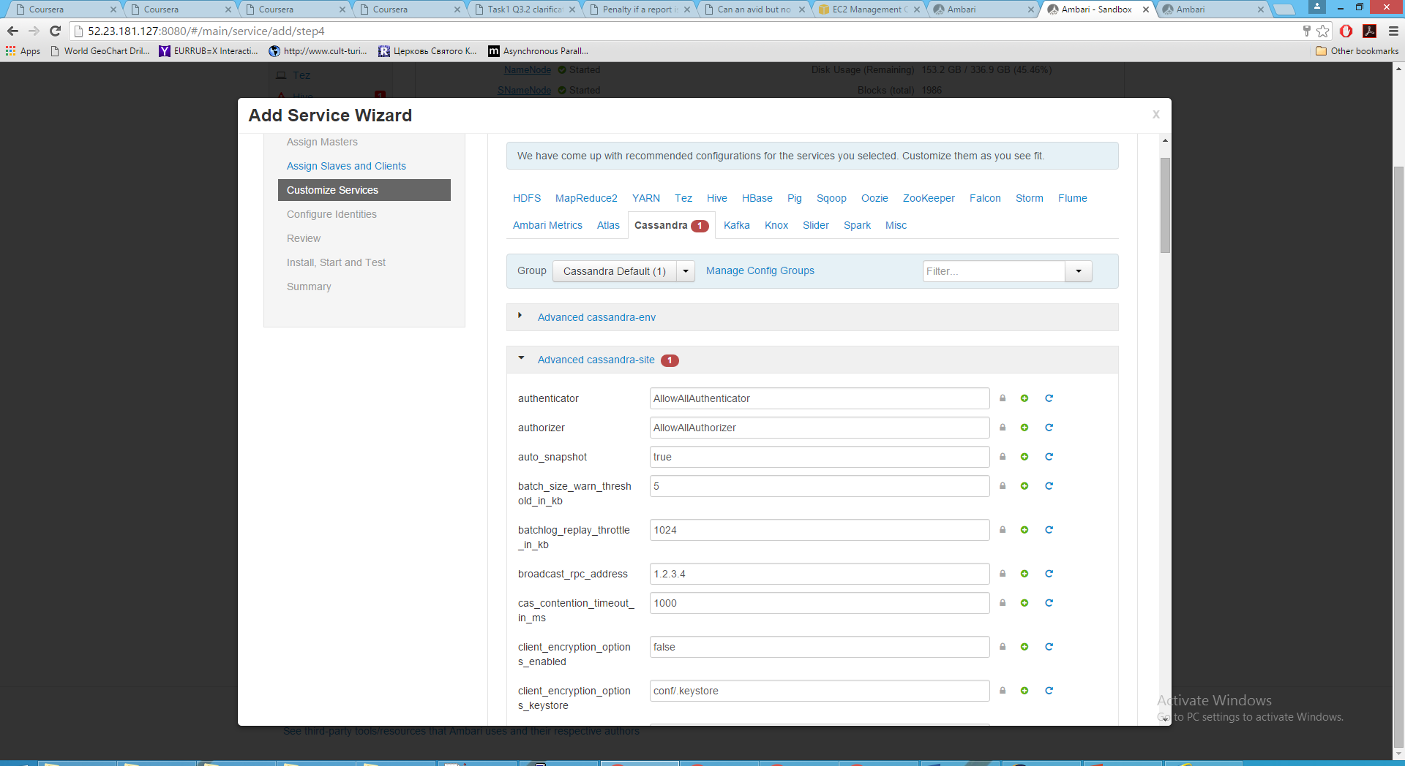
Integration – Cassandra service installation

Slide 28
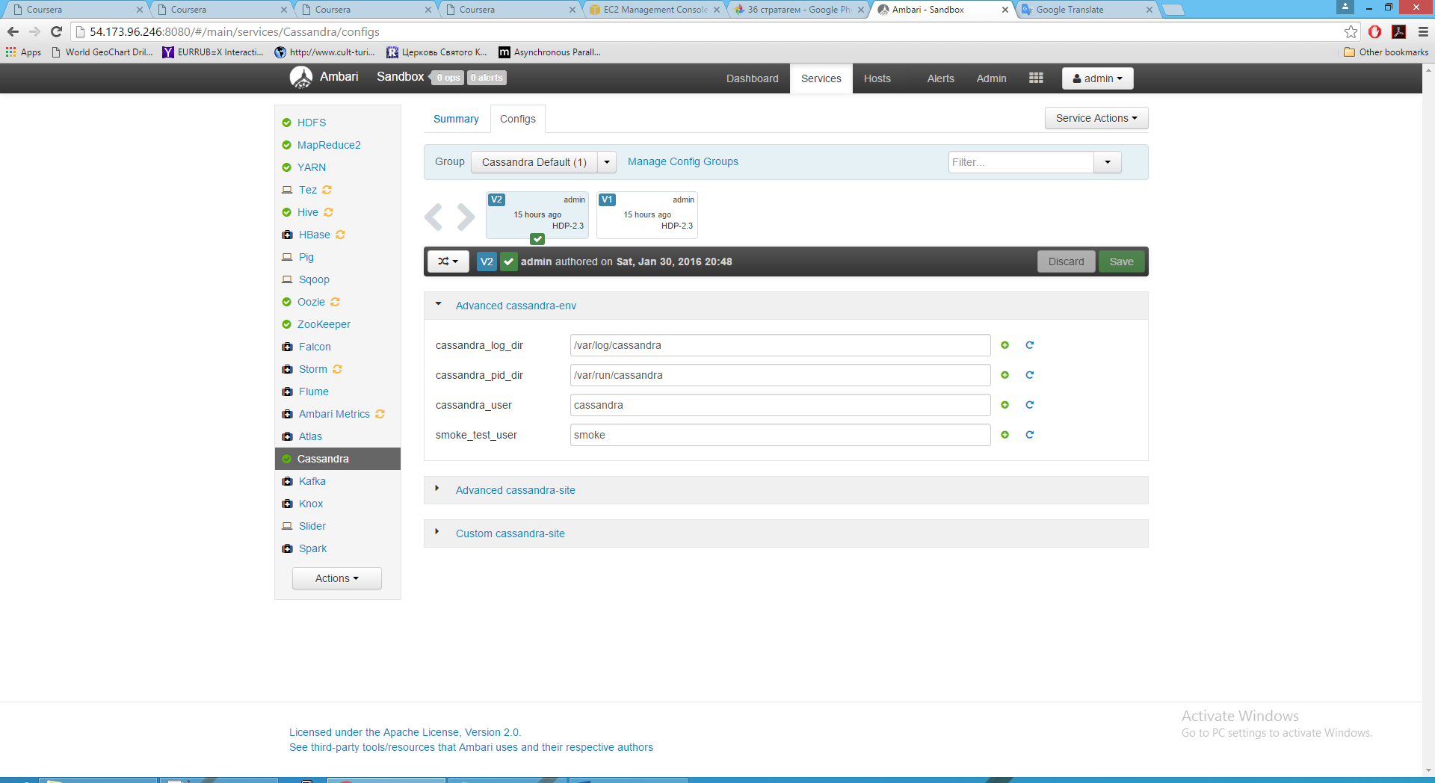
Integration – Cassandra service up and running

Slide 29
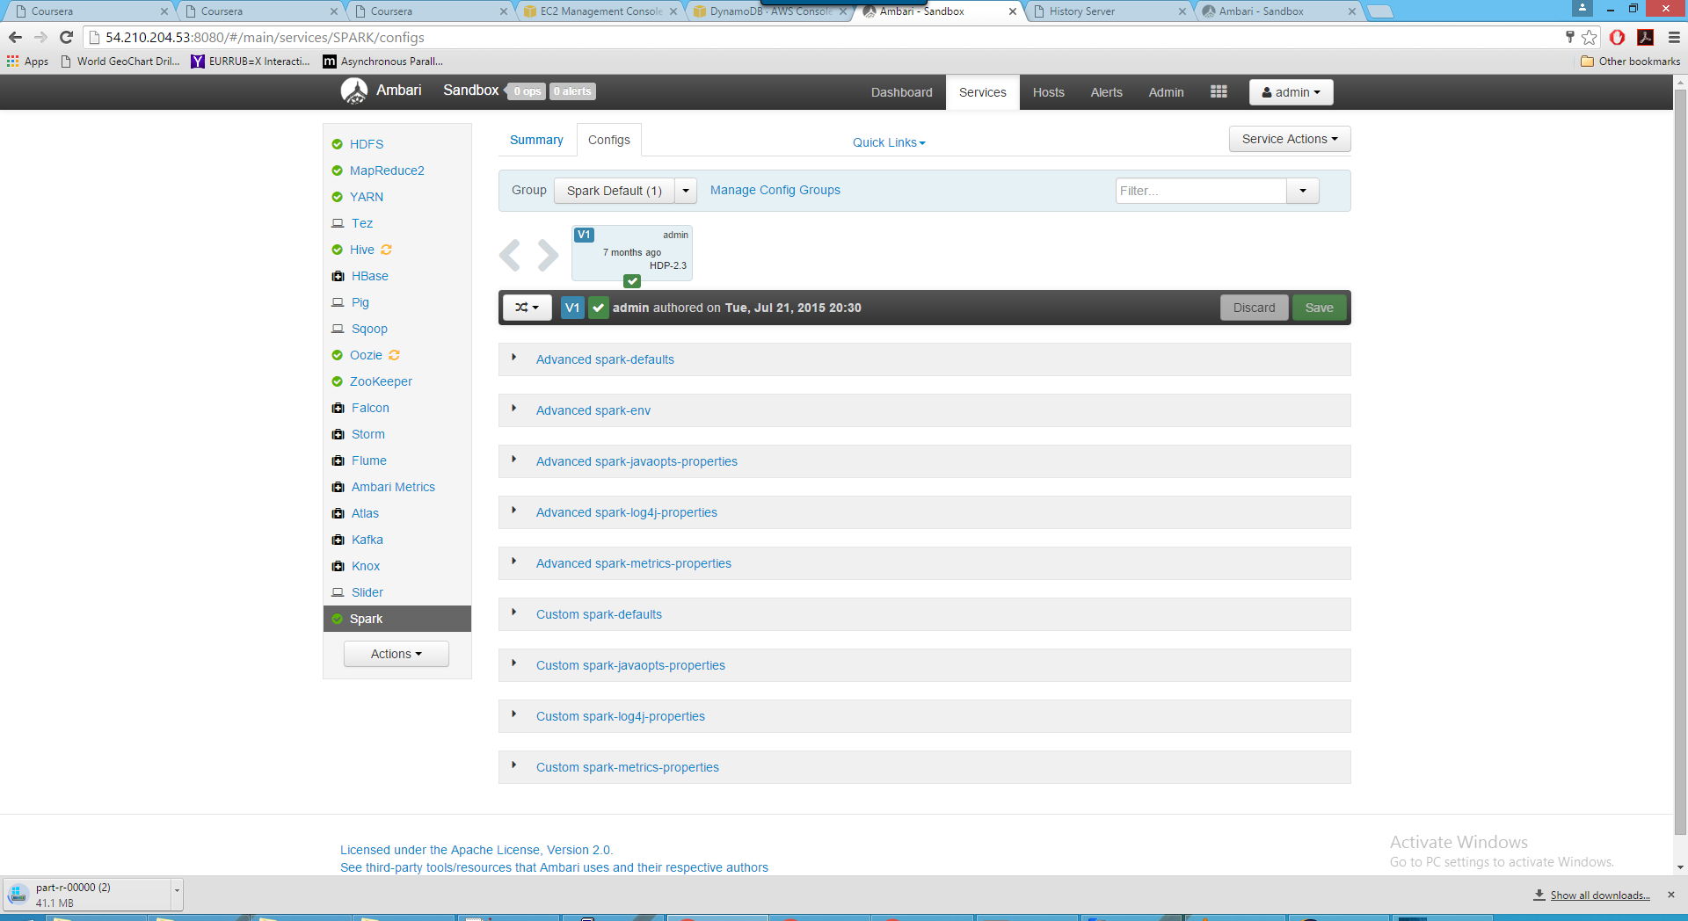
Integration – Spark service up and running

Slide 30
Thank you

